Slide 1

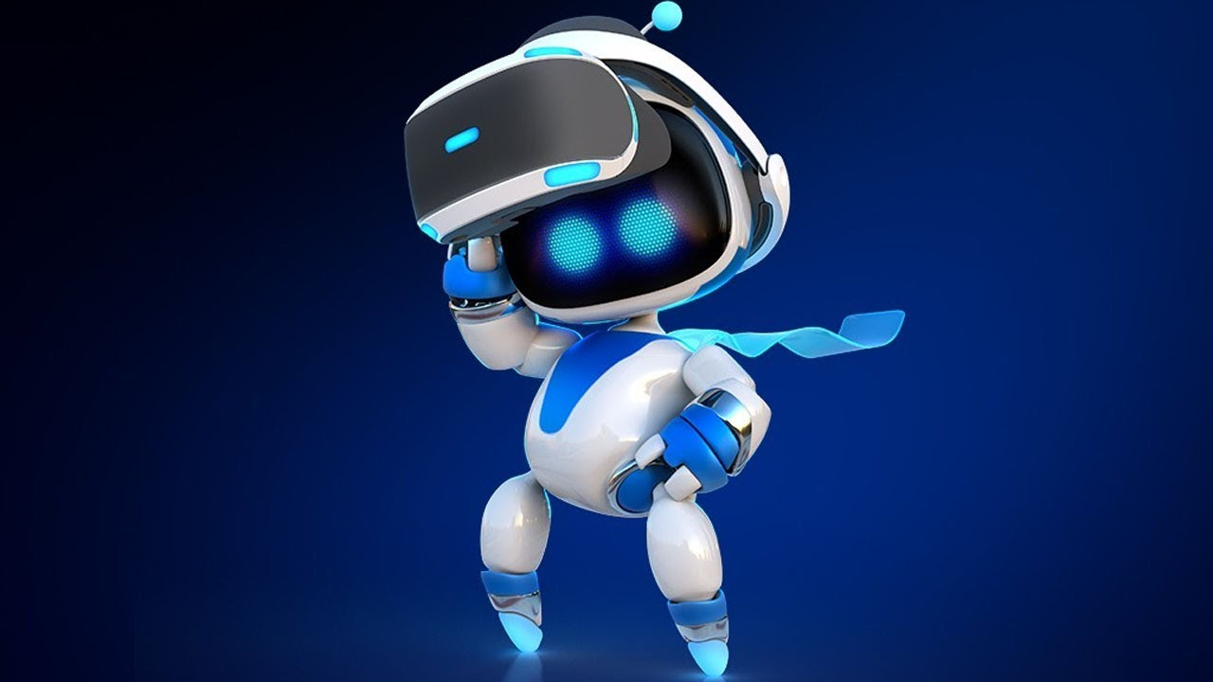
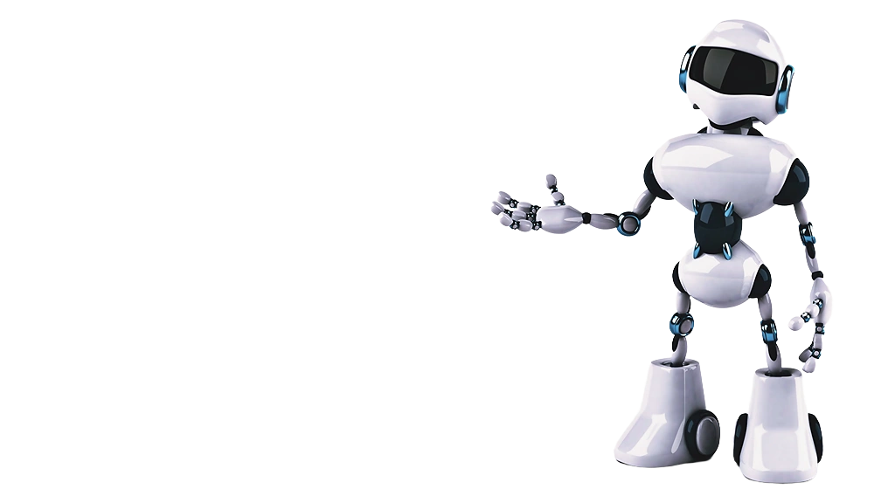
Government Polytechnic Pune
Information Technology
Shreya Rajaram Patil
Enrollment no. : 2107044

Slide 2
Government Polytechnic Pune
Information Technology
Shreya Rajaram Patil
Enrollment no. : 2107044

Slide 3
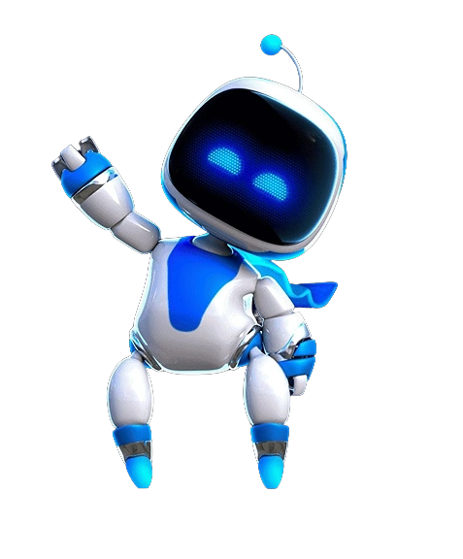
CONTENT
CONTENT
What is Astrotinker Bot?
How does Astrotinker Bot work?
Technology used in Astrotinker bot
Examples of Verilog modules
AstroTinker Bot in various Industries
Case Studies
The Future of Robotics with Astrotinker Bot

Slide 4
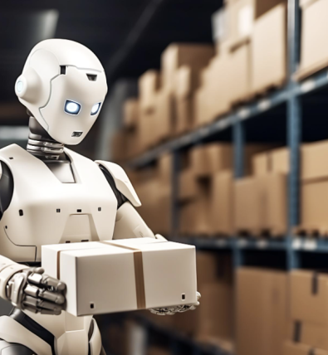
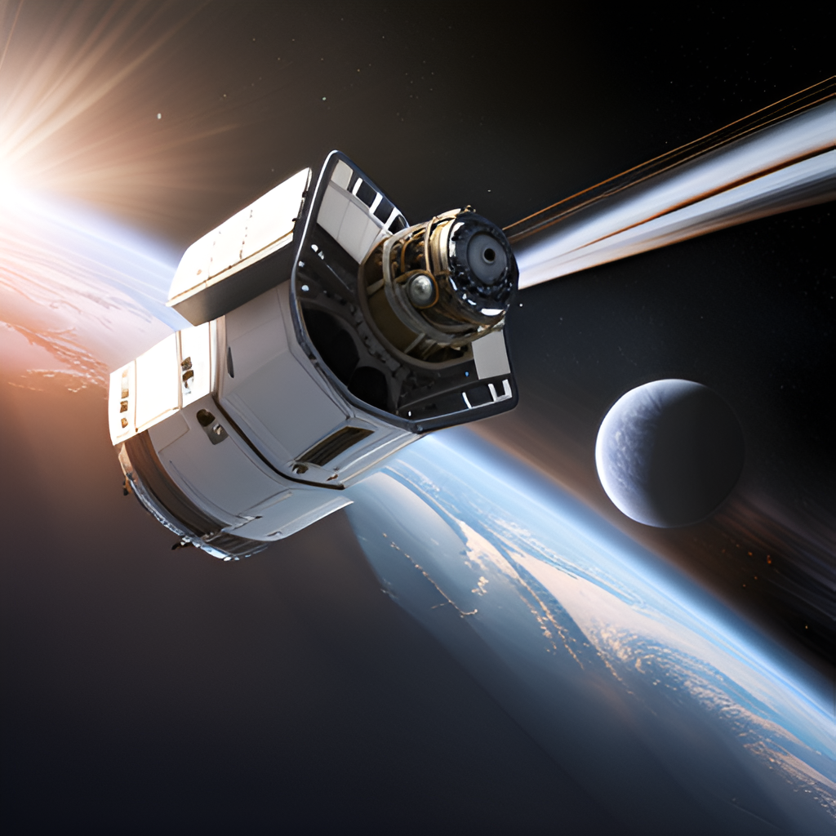
Difference between Robot and Bot

Slide 5
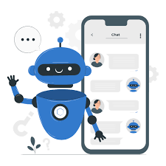
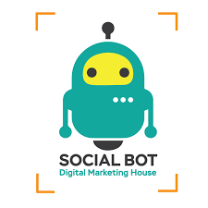
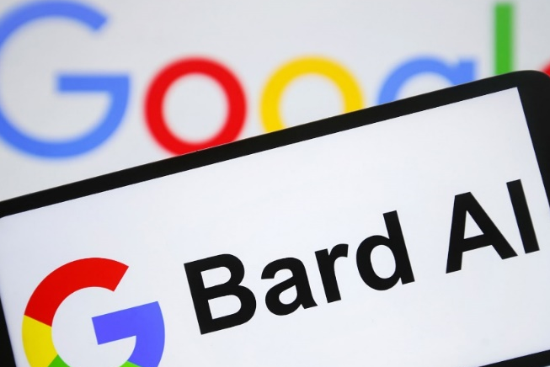
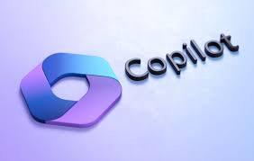
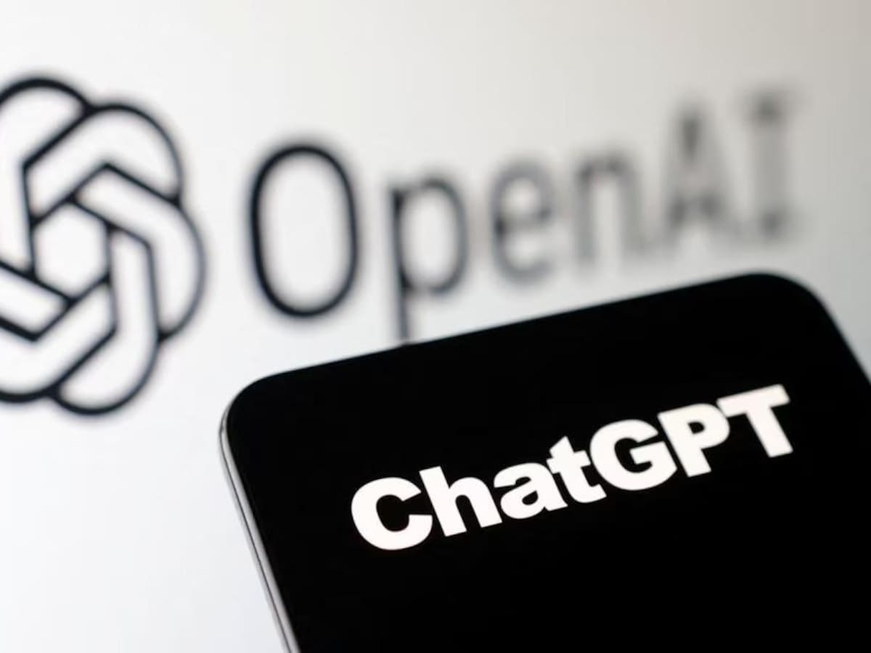
Types of Bots

Slide 6

Types of Bots

Slide 7
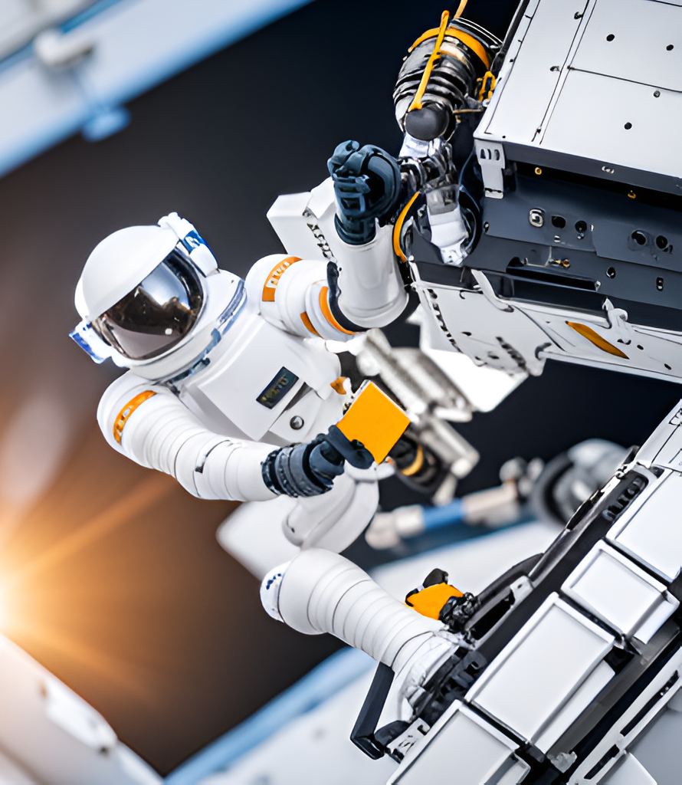
What is AstroTinker Bot?
"AstroTinker Bot is a robot that can help us to learn, to be more creative, and to be more productive."

Slide 8
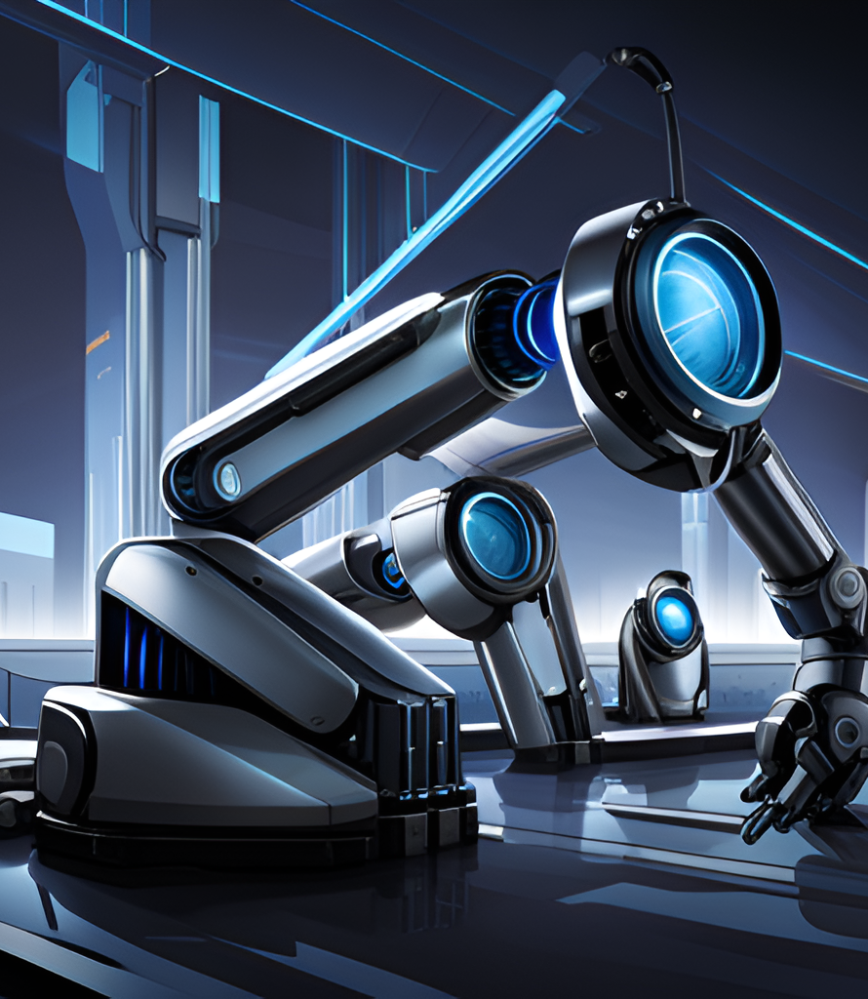
How does AstroTinker Bot work?

Slide 9
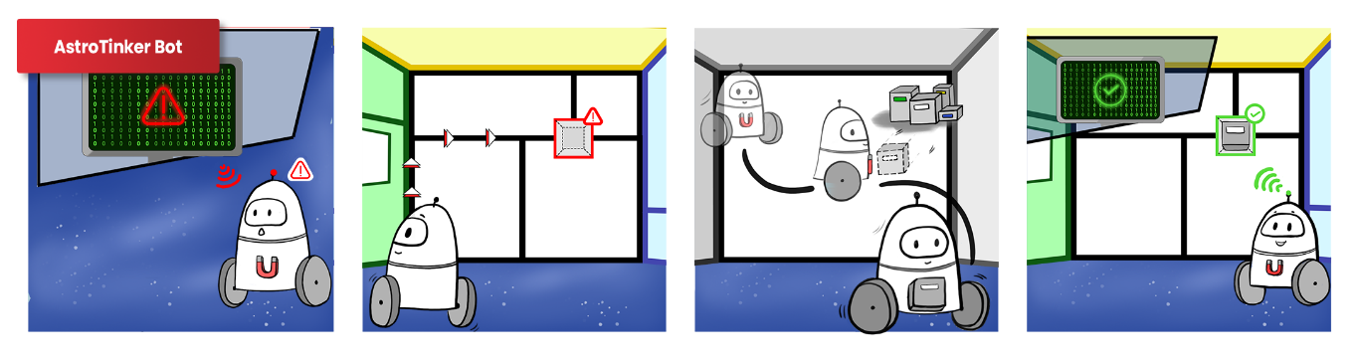
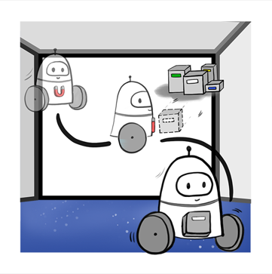
AstroTinker Bot repairs problems on the space station when they arise.
A central hub sends wireless alerts to robots to locate faulty or missing components.
For repairs, it heads to the electronics warehouse.

Slide 10
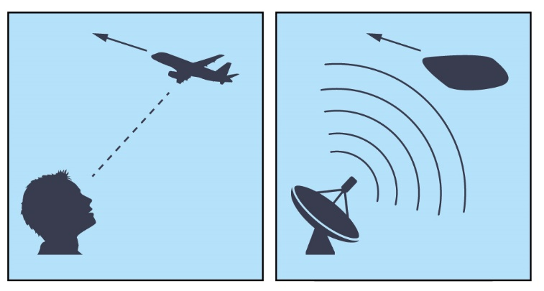
AstroTinker Bot repairs problems on the space station when they arise.
A central hub sends wireless alerts to robots to locate faulty or missing components.
For repairs, it heads to the electronics warehouse.
Uses the combination of lidar, radar, and camera sensors to create a detailed map of its environment.
Uses the map to plan its movements and avoid obstacles.
Lidar
Radar

Slide 11
How does AstroTinker Bot work?
Uses the combination of lidar, radar, and camera sensors to create a detailed map of its environment.
Uses the map to plan its movements and avoid obstacles.
Lidar
Radar

Slide 12
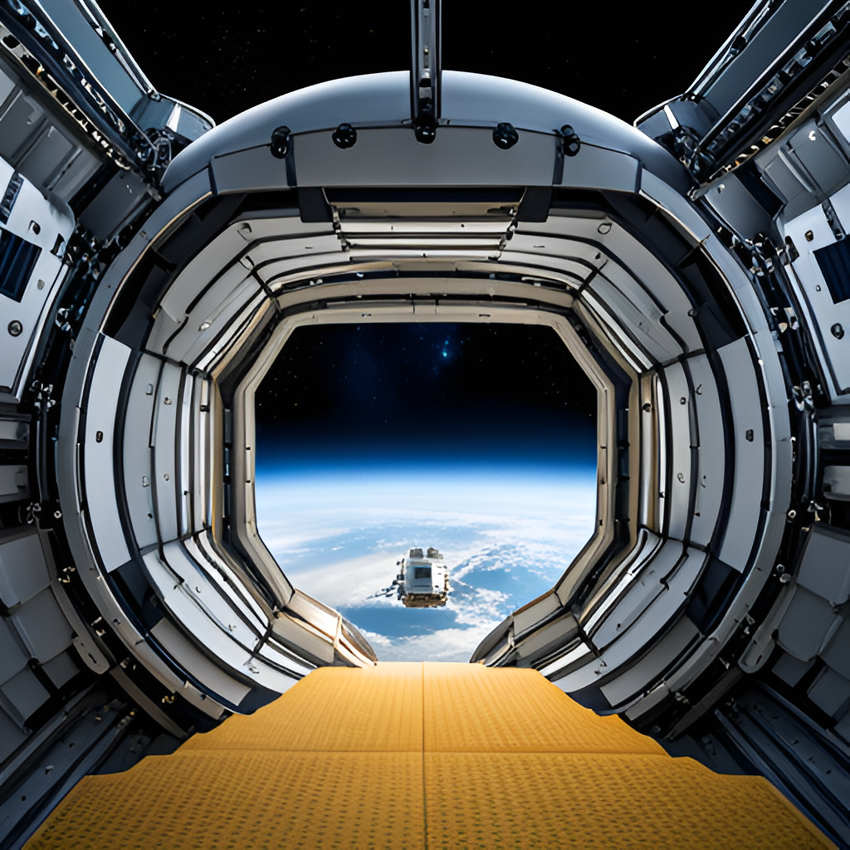

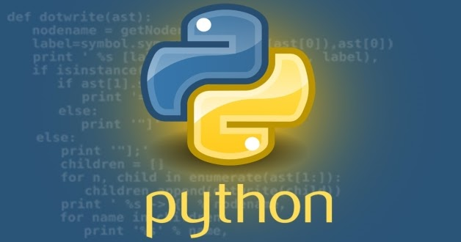


Technology used in
AstroTinker bot

Slide 14
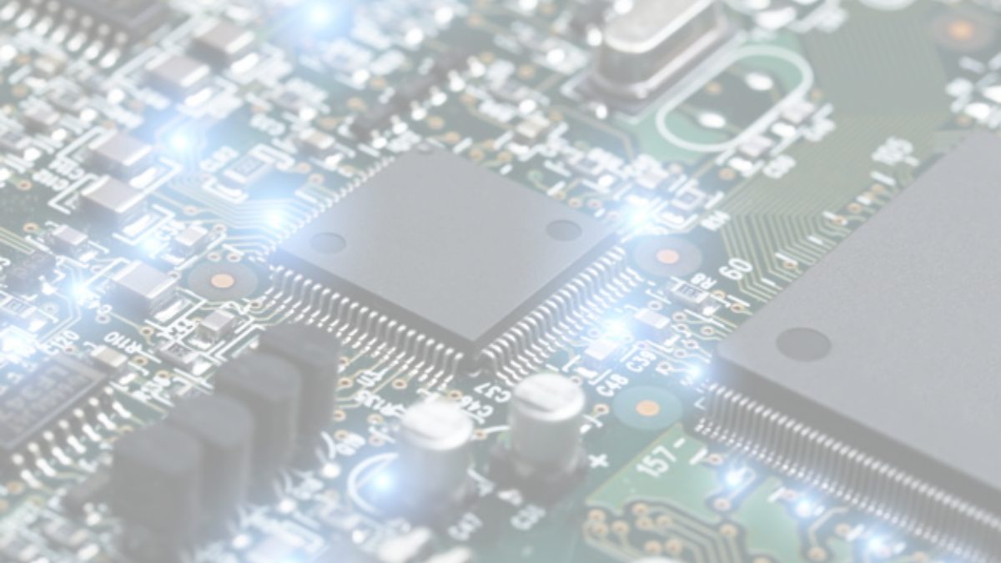
Hardware Description Languages
Verilog HDL​
A high-level computer language can represent and simulate digital design​
Helps to communicate with hardware directly.​
Used to create complex circuits.​
Brings the circuit to the life.​
A language used to describe a digital system, for example, a computer or a component of a computer​
Two Major HDLs in Industry – ​
1. VHDL 2. Verilog HDL​

Slide 15
Hardware Description Languages
Verilog HDL​
A high-level computer language can represent and simulate digital design​
Helps to communicate with hardware directly.​
Used to create complex circuits.​
Brings the circuit to the life.​
A language used to describe a digital system, for example, a computer or a component of a computer​
Two Major HDLs in Industry – ​
1. VHDL 2. Verilog HDL​

Slide 16
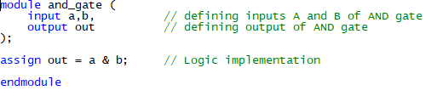
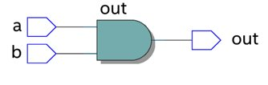
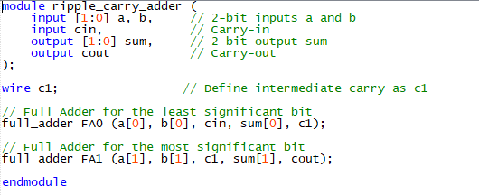
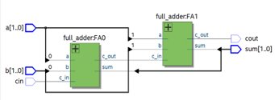
Examples of Verilog Modules :

Slide 17
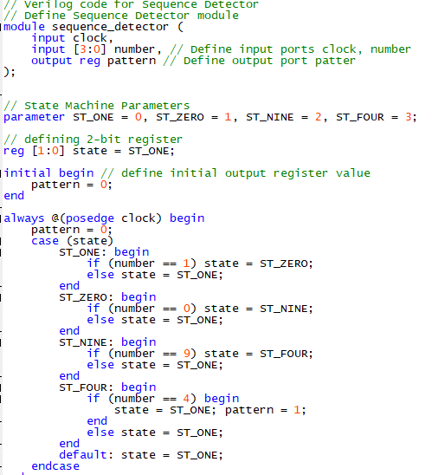
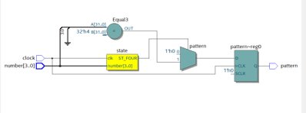
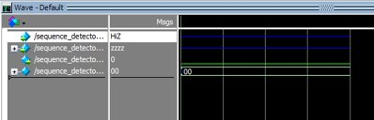
Examples of Verilog Modules :

Slide 18

AstroTinker Bot in various industries

Slide 19
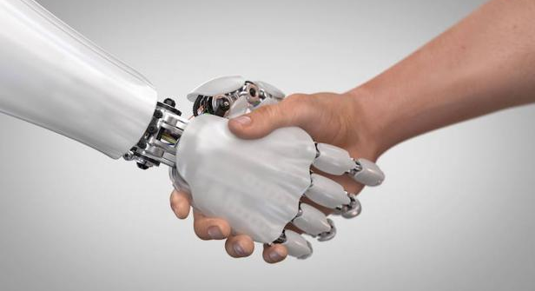
Automation Helps to Reduce Human Error
Automates repetitive tasks, reducing errors and increasing output.
Notes:
19

Slide 20
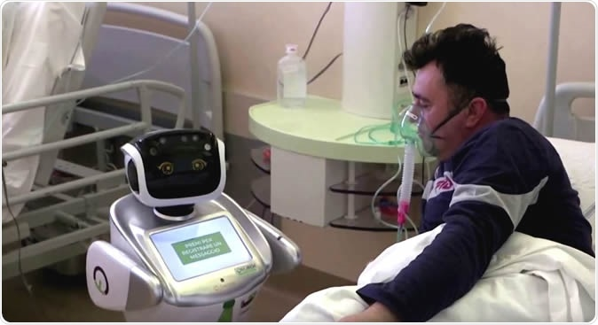
Robots has play a major role in COVID-19 battle
Assists medical professionals with patient care, minimizing the risk of infection.
Notes:
20

Slide 21
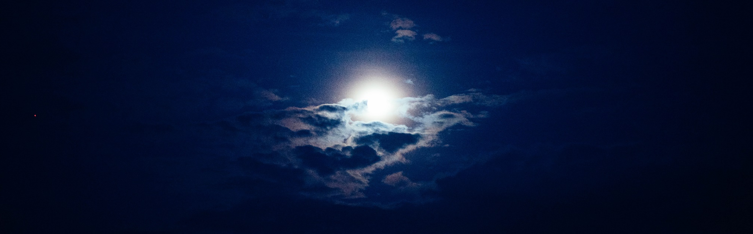
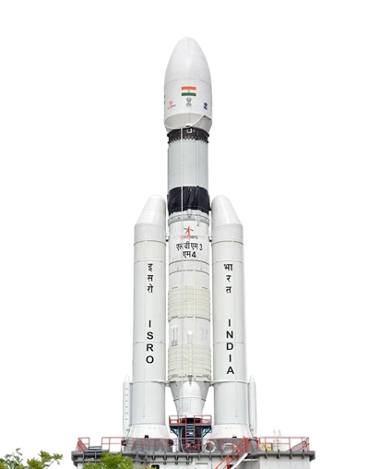
Case Studies :
Chandrayaan - 3

Slide 22
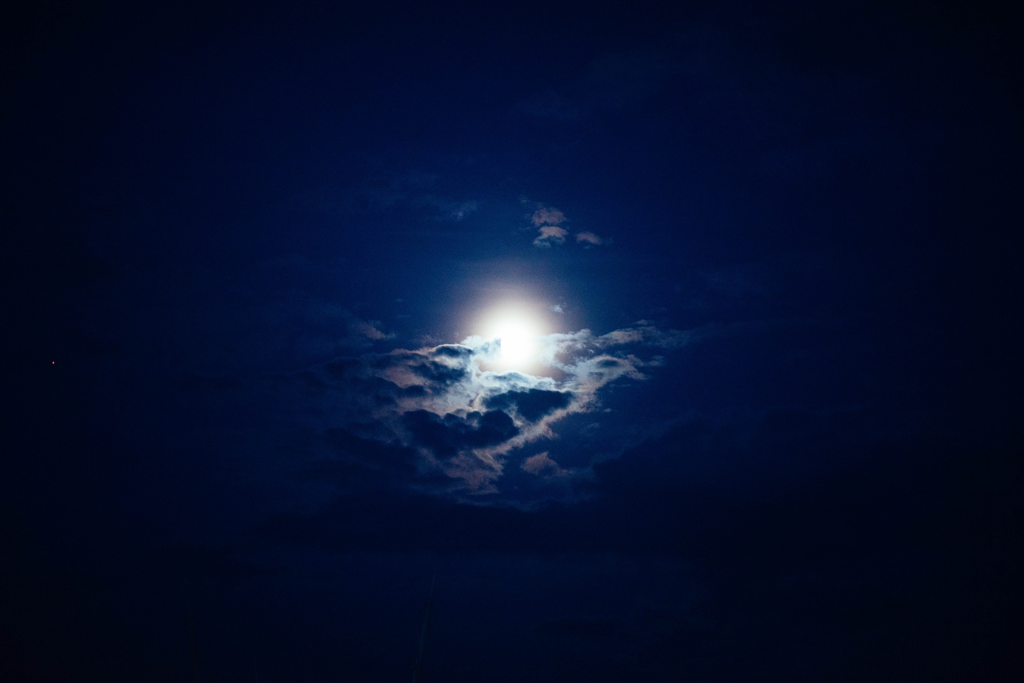
Technology

Slide 23
Pragyan rover - to explore lunar surface
Vikram lander - to deliver Pragyan to lunar surface
LVM3 launch vehicle - to launch Chandrayaan-3 into orbit
Ground stations - to communicate with Chandrayaan-3 and receive data

Slide 24
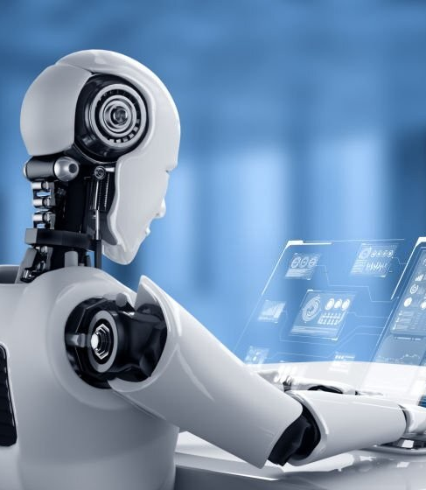
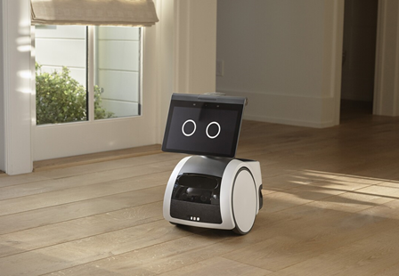
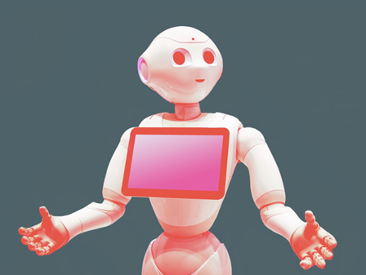
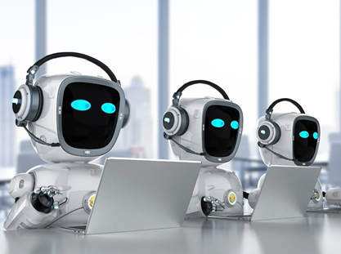
The Future of Robotics with Astrotinker Bot
Robots like AstroTinker Bot
will work alongside humans and augment their abilities.​
These robots will perform repetitive tasks and assist in complex decision-making processes.​
As technology advances, we may see robots that are capable of learning and adapting to new situations on their own.​

Slide 25
The Future of Robotics with Astrotinker Bot
Robots like
Astro- Tinker Bot will work alongside humans and increase their
abilities.​
These robots will
perform repetitive tasks and assist in complex decision-making processes.​
As technology advances, we may see robots that are capable of learning and adapting to new situations on their own.​

Slide 26
Conclusion
At the end of presentation , I hope you have better understanding about the AstroTinker .
AstroTinker bot is under development , but still has made a significant Progress , and is being used in organizations and various industries to improve the customer service , increase sells and reduce the cost .
As the technology advances , we expect to see more enhance to the AstroTinker Bot.

Slide 27
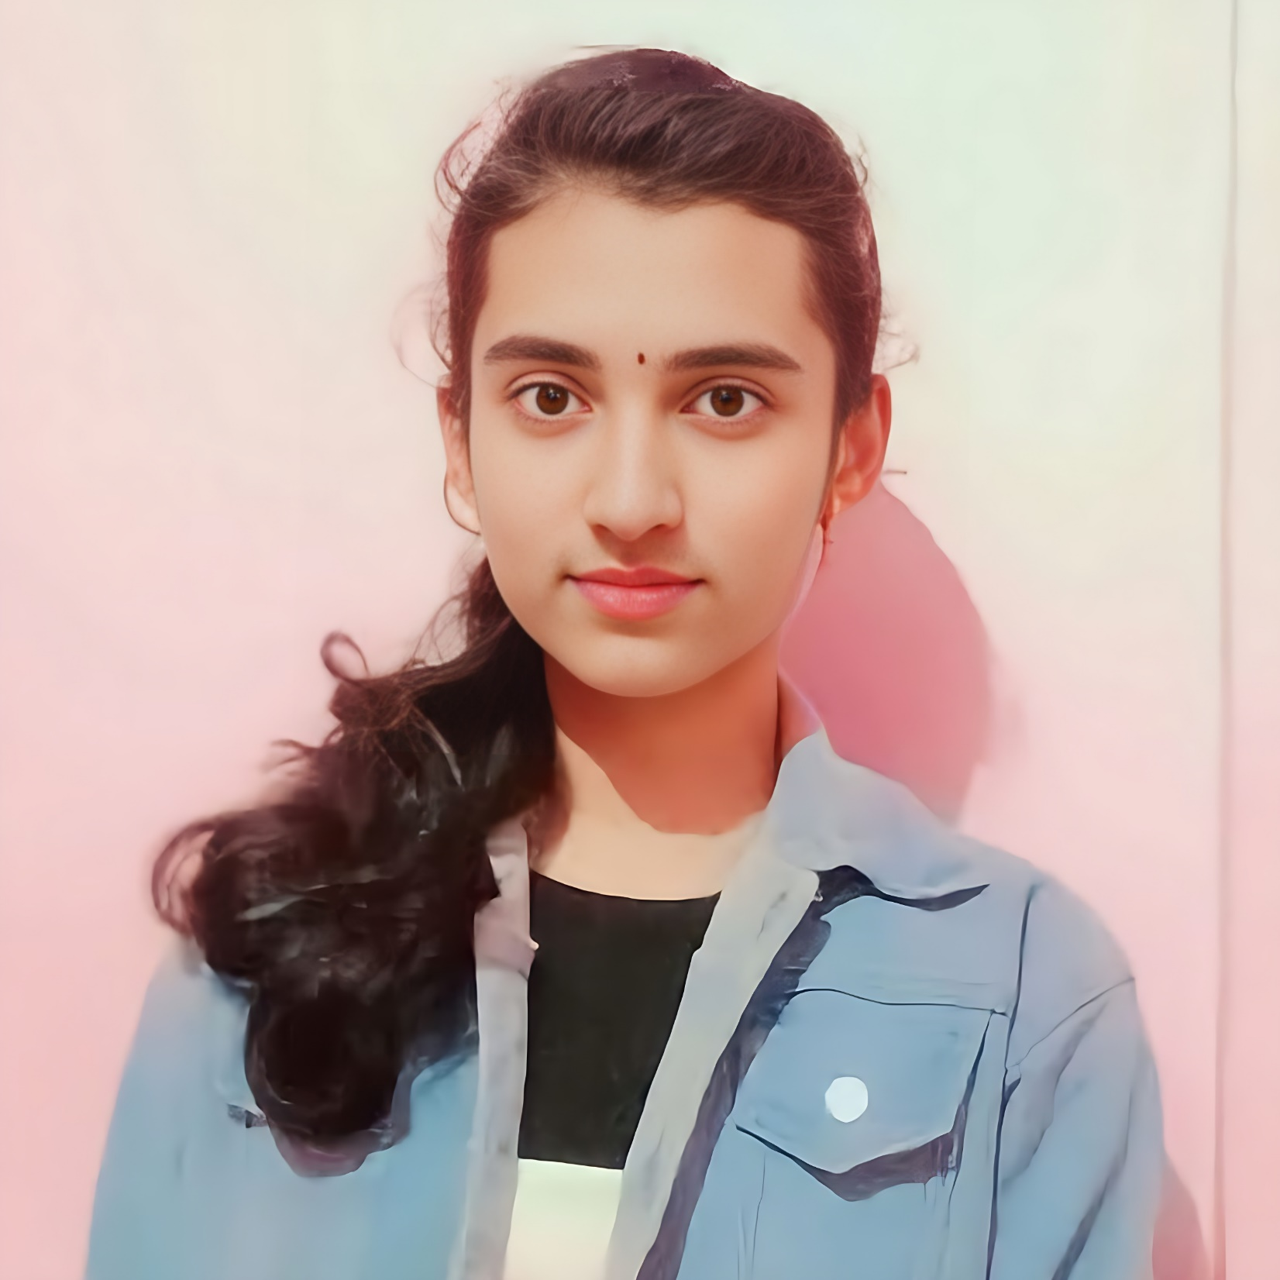
Thank you !
Your feedback is essential to helps to improve presentation . Thank you again for your time and attention. We look forward to hearing from you soon!

